Slide 1
How to order and activate an electronic resource which is not yet available in the Community Zone – the electronic collection is known
Yoel Kortick
Senior Librarian

Slide 2

Agenda
Introduction
Our example
Catalog the title in the institution and create local portfolio in the electronic collection
Order and activate the resource in the institution
Link the resource to a collection in the Community Zone

Slide 3
Introduction
3

Slide 4
Introduction
In this presentation we will show a suggested method for the institution to order and activate an electronic resource which is not yet available in the Community Zone but is already available from the vendor.
In this example the institution knows which electronic collection the portfolio will eventually be part of.

Slide 5
Our example
5

Slide 6
Our example
In the example here the vendor has already made the title “Research Methods in Library and Information Science” available to the institution, and the institution wants to purchase and activate it.
This title will be part of the electronic collection “ABC-CLIO eBooks”, which has already been activated by the institution from the CZ. However, this specific title is not yet in this electronic collection in the CZ.

Slide 7
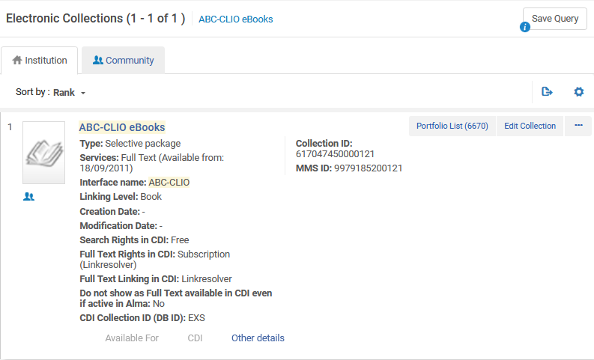
Our example
The electronic collection “ABC-CLIO eBooks” has already been activated by the institution from the CZ, but it does not contain title “Research Methods in Library and Information Science”

Slide 8
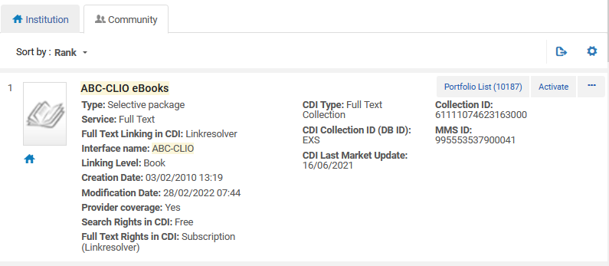
Our example
Let’s check the Portfolio List” of the electronic collection “ABC-CLIO eBooks” in the CZ.

Slide 9
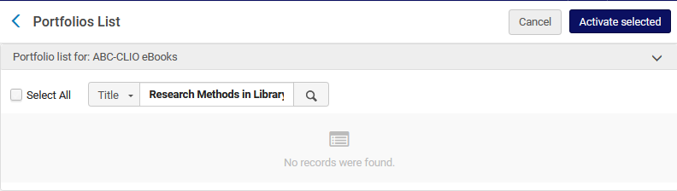
Our example
The Portfolio “Research Methods in Library and Information Science” is not there.

Slide 10
Catalog the title in the institution and create local portfolio in the electronic collection
10

Slide 11
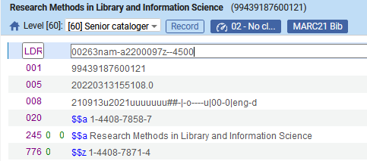
Catalog the title in the institution and create local portfolio in the electronic collection
Catalog the title in the institution
The ISBN or ISSN is important because it will be used later to link the record to a CZ record.

Slide 12
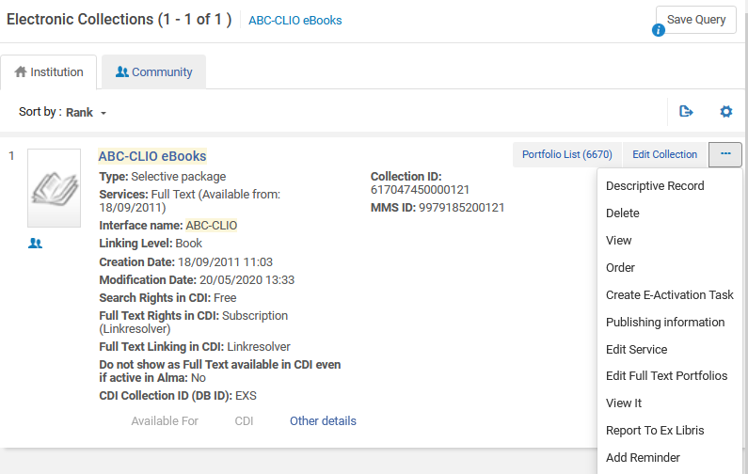
Catalog the title in the institution and create local portfolio in the electronic collection
From the Institution Zone edit the service of the Community Zone electronic collection to which the local portfolio will be connected.
We could also click here “Edit Full Text Portfolios” which would bring us straight to the “portfolios” tab.

Slide 13
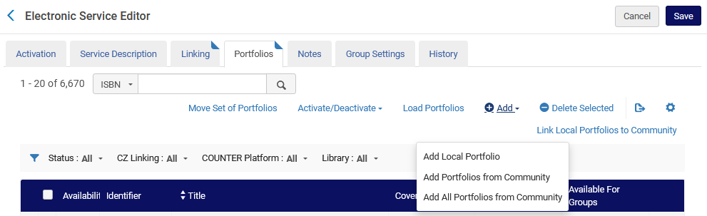
Catalog the title in the institution and create local portfolio in the electronic collection
From the “Portfolios” tab choose “Add Local Portfolio”.

Slide 14
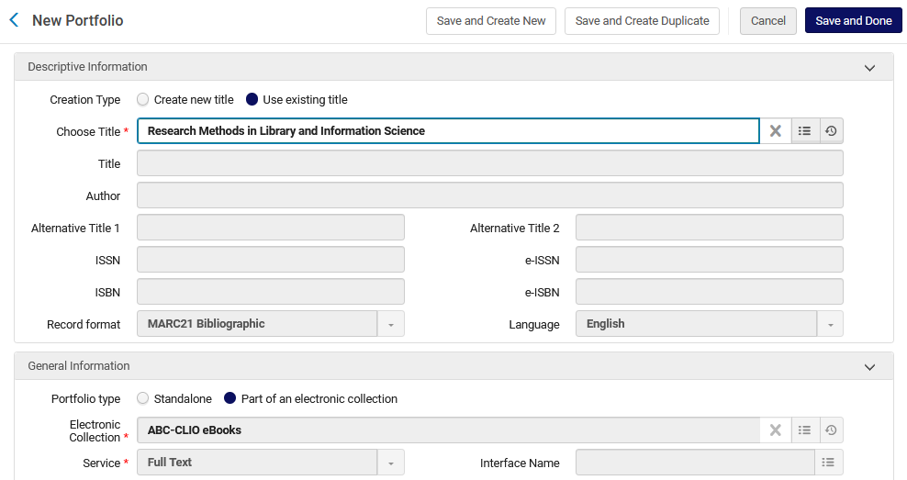
Catalog the title in the institution and create local portfolio in the electronic collection
Use Existing title and choose the title we catalogued
Leave the Portfolio type “part of an electronic collection”

Slide 15
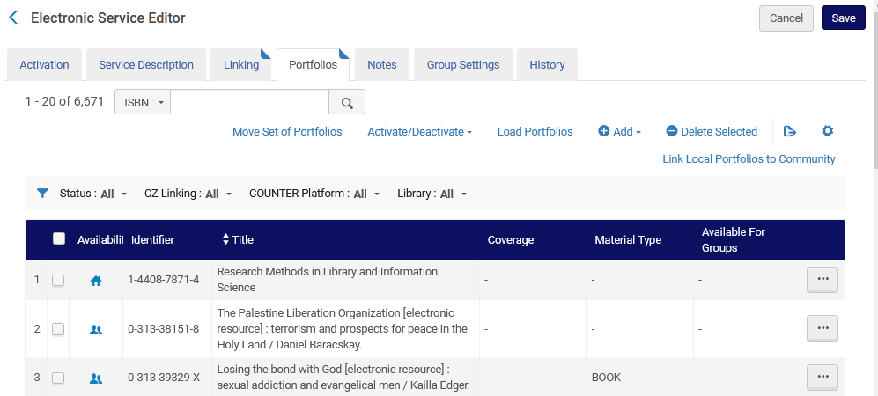
Catalog the title in the institution and create local portfolio in the electronic collection
Now we have a local portfolio in the Community Zone collection
The “house” icon means it is a local portfolio.

Slide 16
Order and activate the resource in the institution
16

Slide 17
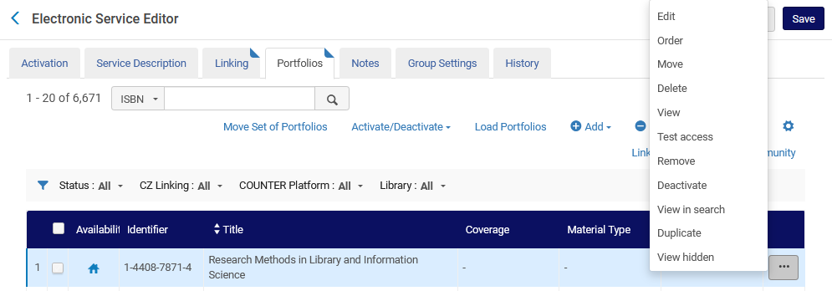
Order and activate the resource in the institution
Order the resource (here we do it from the electronic service editor)

Slide 18
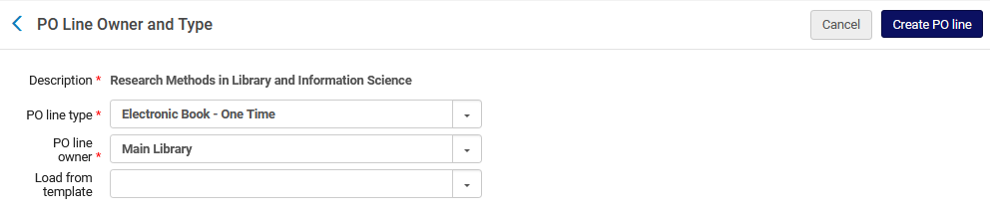
Order and activate the resource in the institution
Create an order (POL) for the resource

Slide 19
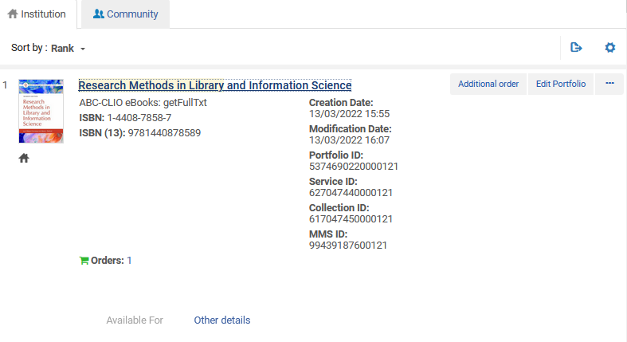
Order and activate the resource in the institution
Now there is a POL and a non activated electronic resource (created from the POL) in the institution

Slide 20
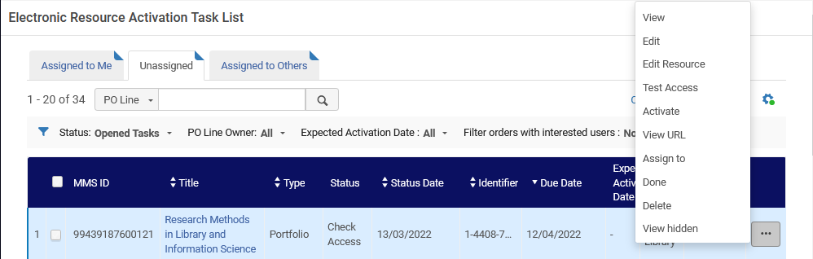
Order and activate the resource in the institution
Activate the resource. Here we are doing so from the Electronic Resource Activation Task List

Slide 21
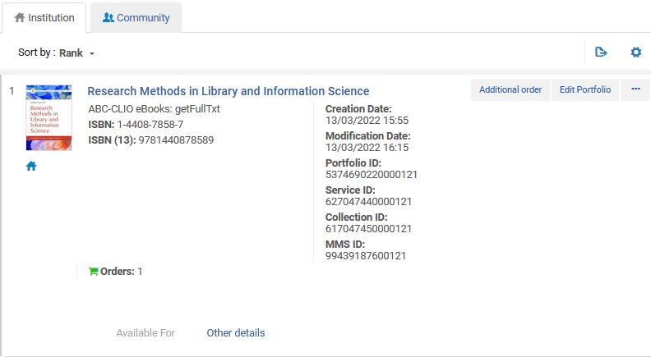
Order and activate the resource in the institution
Now the resource is active in the institution and part of CZ electronic collection as a local portfolio
A local portfolio

Slide 22
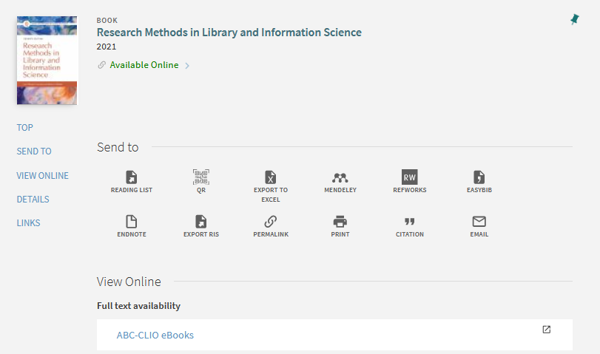
Order and activate the resource in the institution
The resource is available to end users in discovery

Slide 23
Link the resource to a collection in the Community Zone
23

Slide 24
Link the resource to a collection in the Community Zone
In addition to what we show here, you may wish to also see:
  How to link Alma local portfolios (standalones) to the Community Zone
  How to link a set of portfolios to a Community Zone collection
  Linking a Local Portfolio that is part of a Community Zone-Linked Collection to the Community Zone

Slide 25
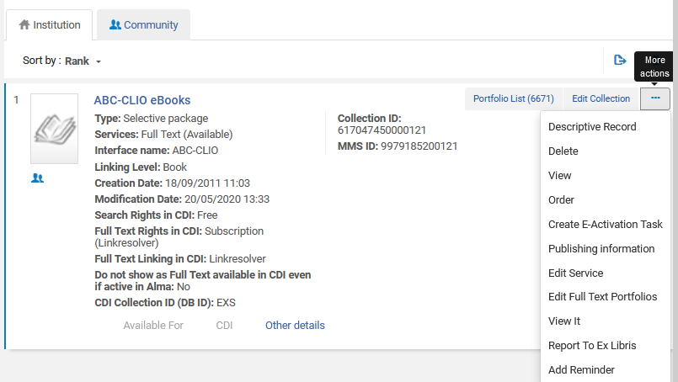
Link the resource to a collection in the Community Zone
When the portfolio will be added to the CZ we can link the local portfolio to the CZ. Again, we will edit the service of the electronic collection.
We could also click here “Edit Full Text Portfolios” which would bring us straight to the “portfolios” tab.

Slide 26
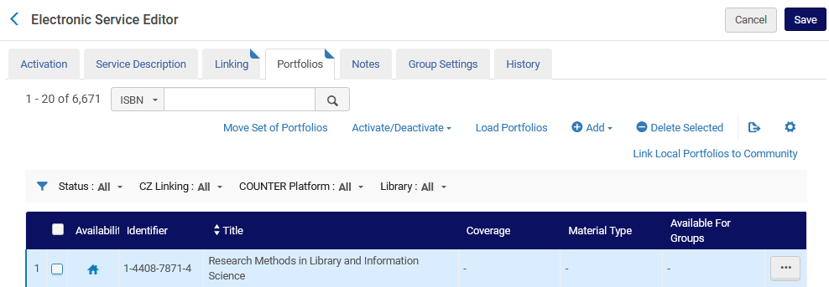
Link the resource to a collection in the Community Zone
From the “portfolios” tab we will click “Link Local Portfolios to Community”

Slide 27
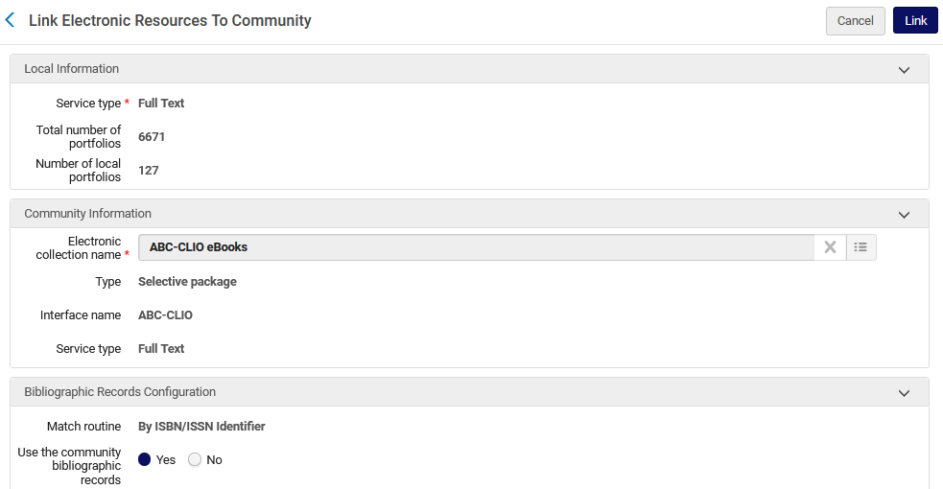
Link the resource to a collection in the Community Zone
We have left the default to use the “community bibliographic record” (instead of the version we catalogued)

Slide 28
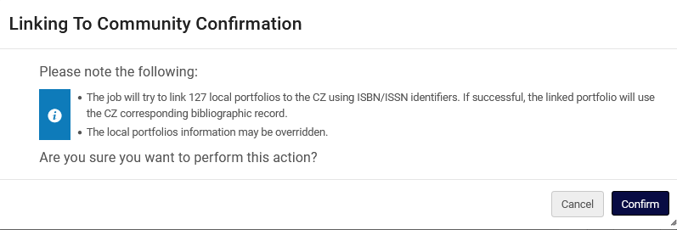
Link the resource to a collection in the Community Zone
Confirm that the job will run

Slide 29
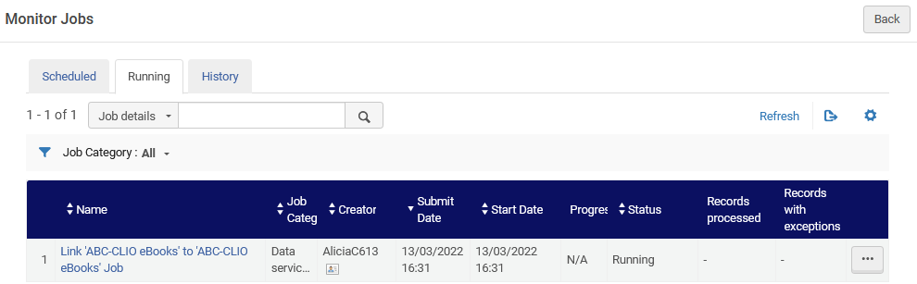
Link the resource to a collection in the Community Zone
The job to link the portfolio(s) runs

Slide 30
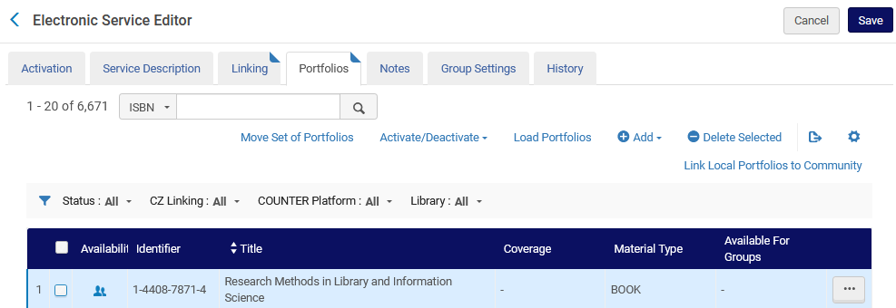
Link the resource to a collection in the Community Zone
The portfolio is linked to the Community Zone

Slide 31
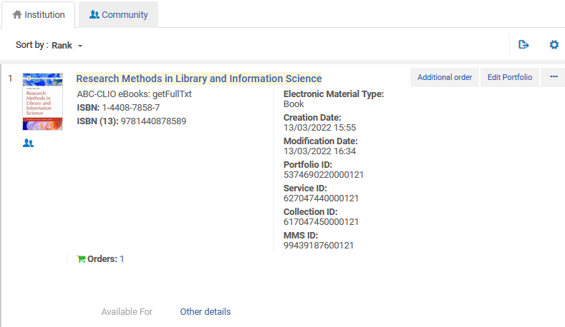
Link the resource to a collection in the Community Zone
The portfolio is linked to the Community Zone

Slide 32
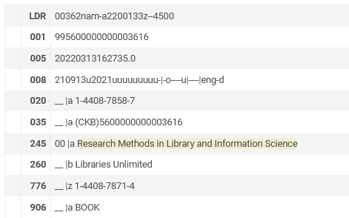
Link the resource to a collection in the Community Zone
The bibliographic information is from the Community Zone because we chose to “to use the “community bibliographic record” (instead of the version we catalogued)”
We have a 035, 260 and 906 field, which we did not have in our catalogued local record.

